Slide 1
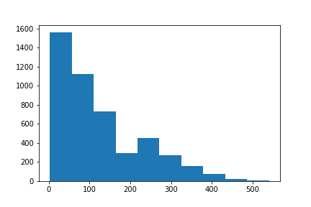
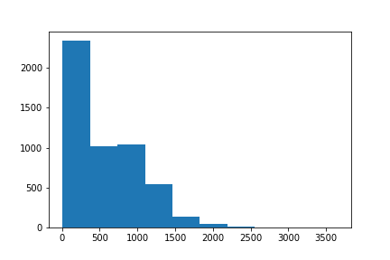
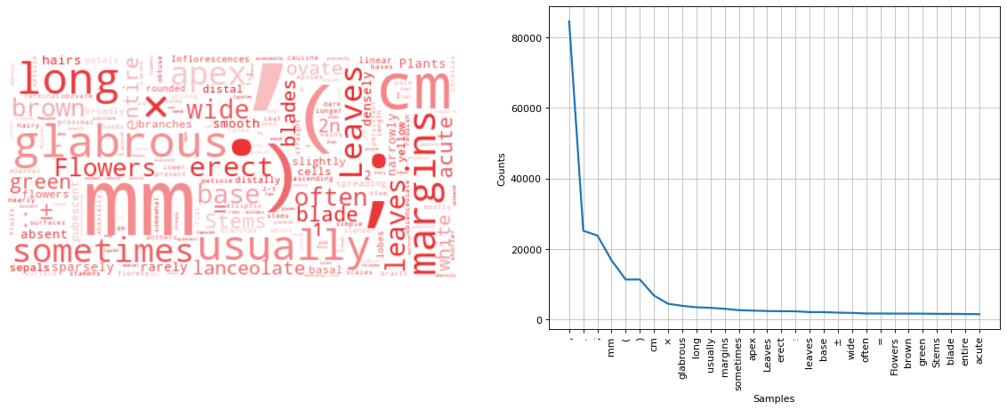
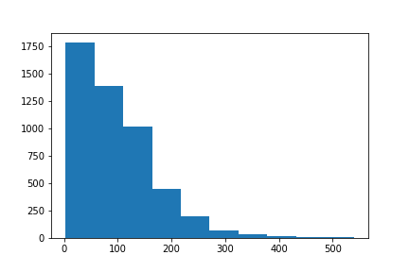
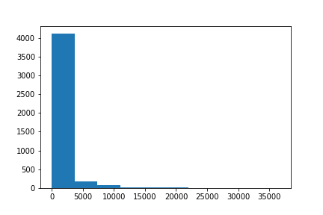
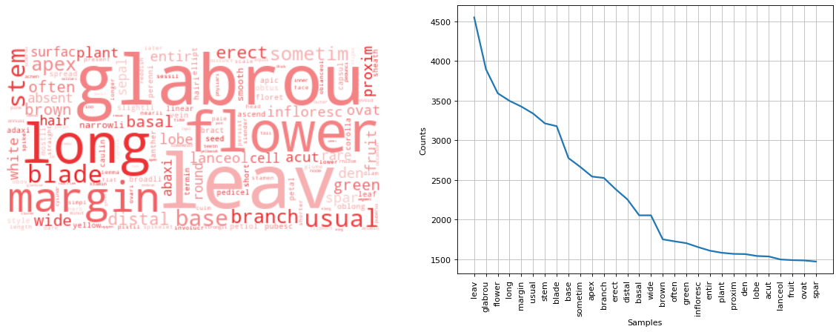
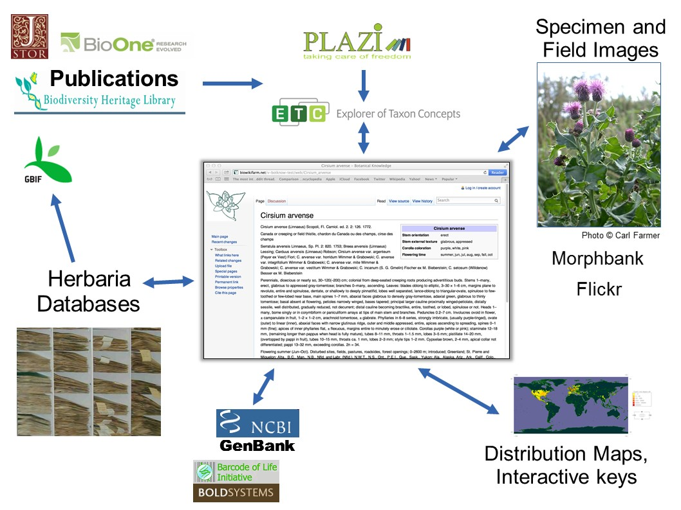
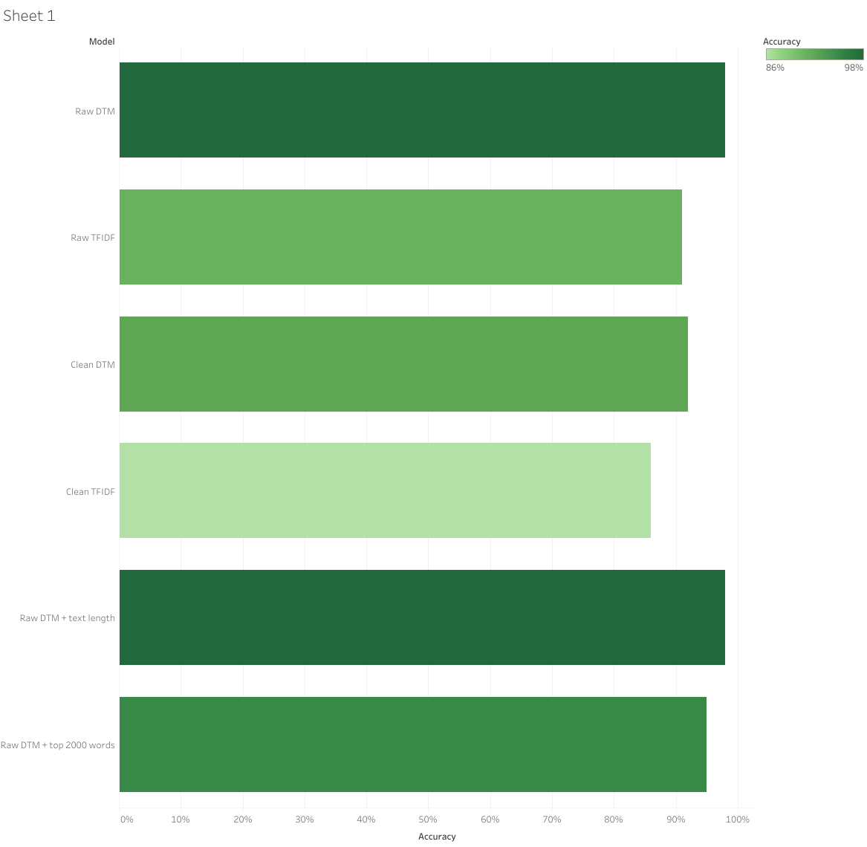
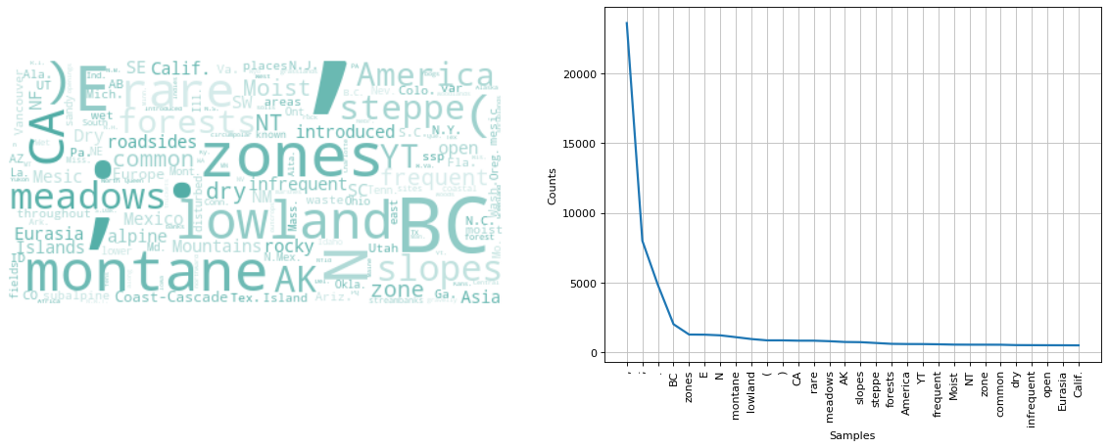
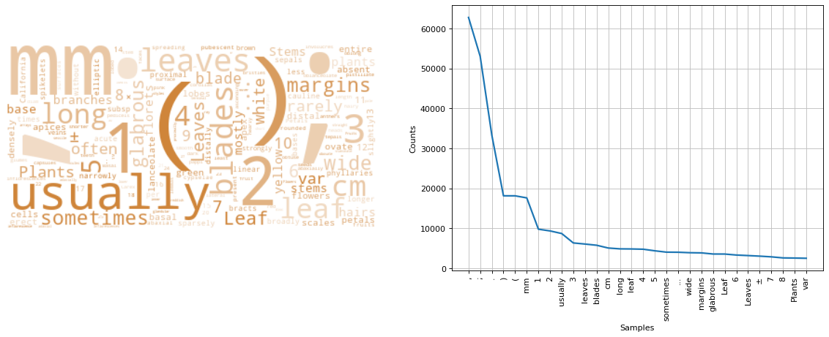
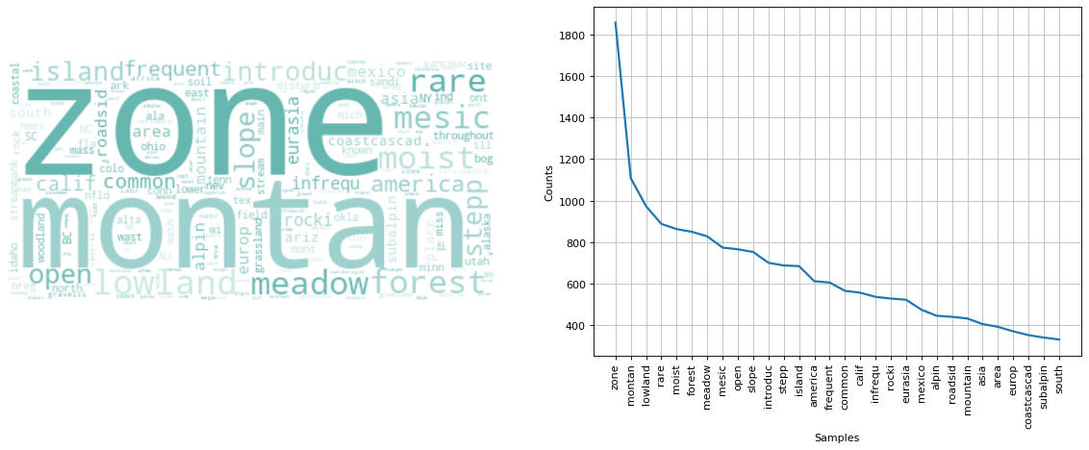
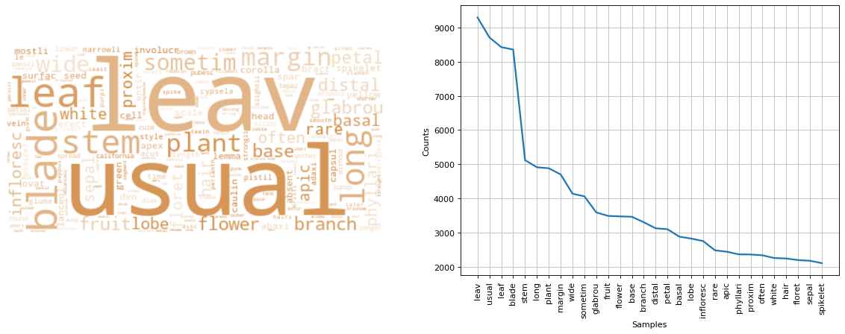
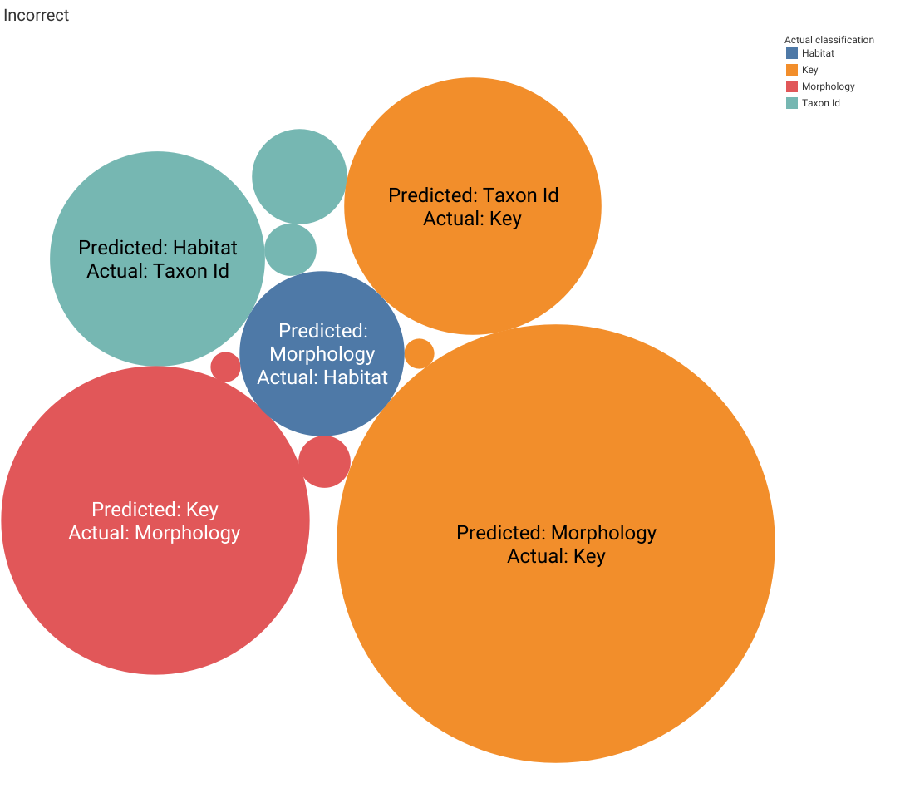
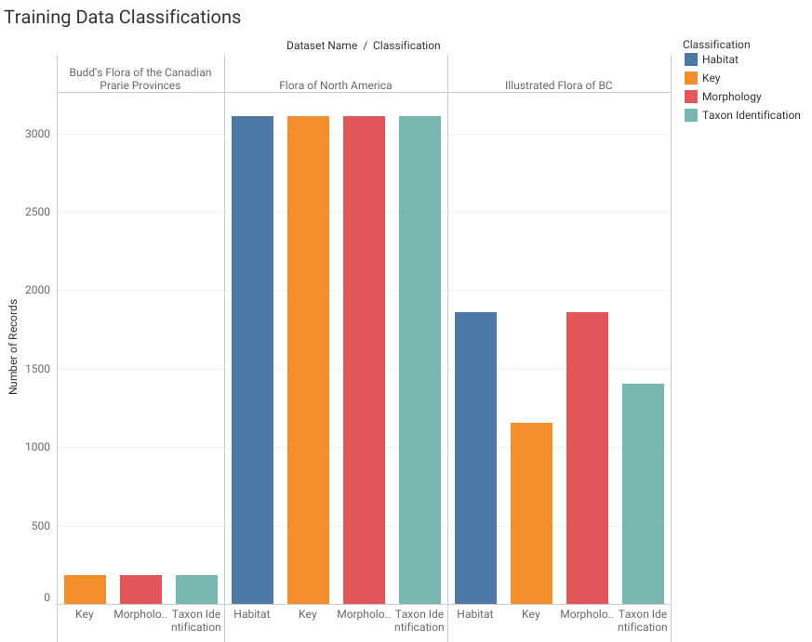
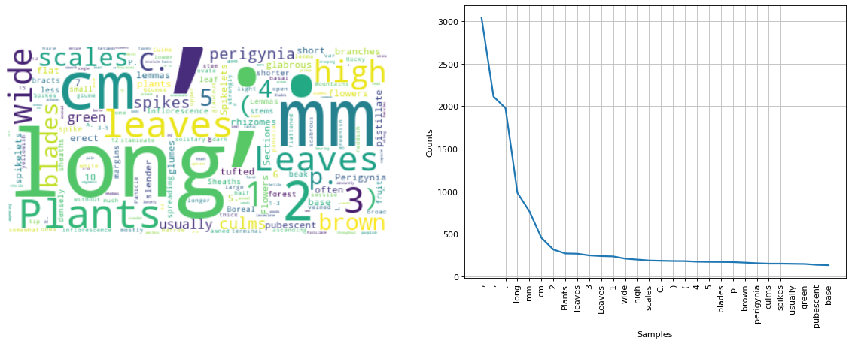
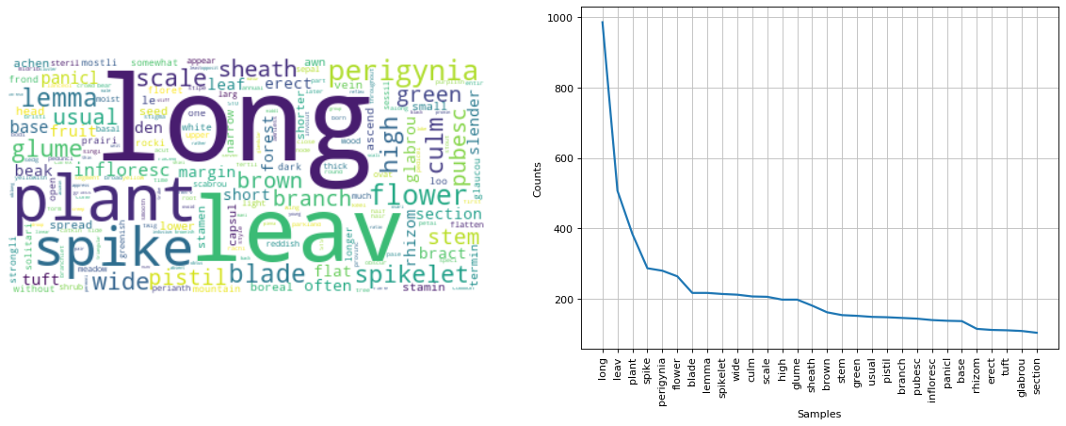
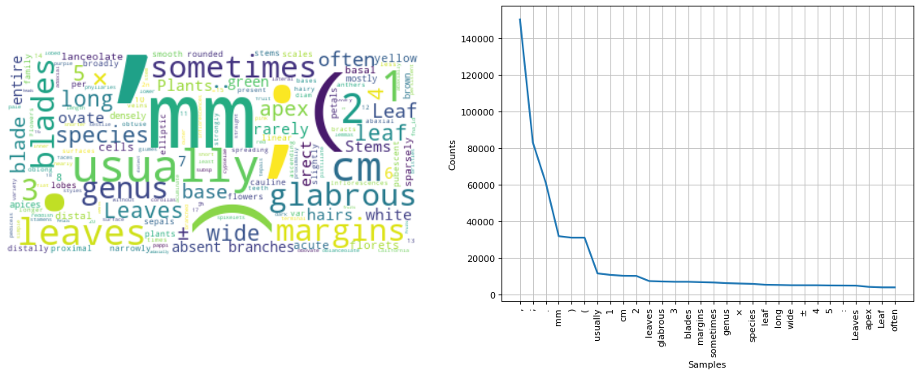
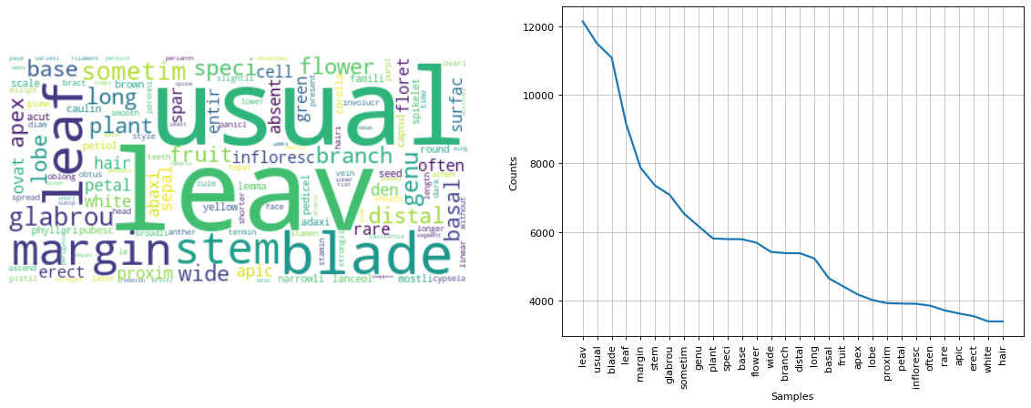
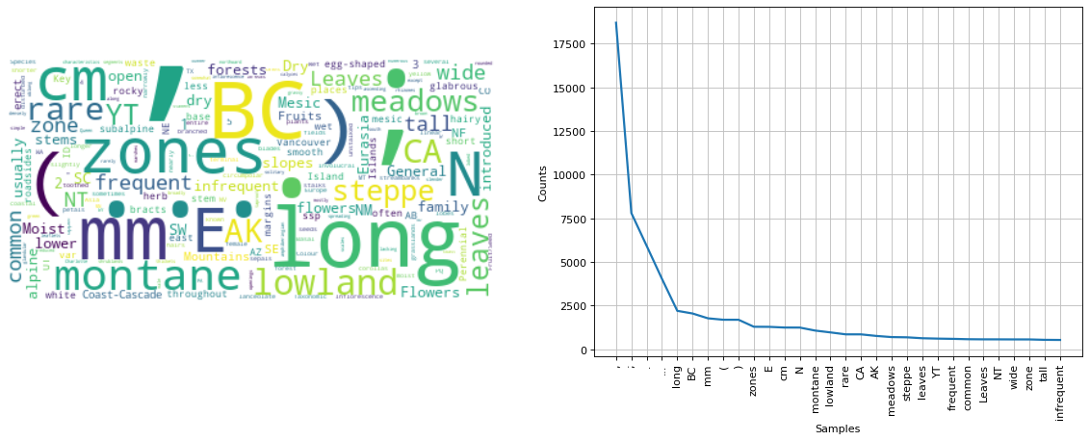
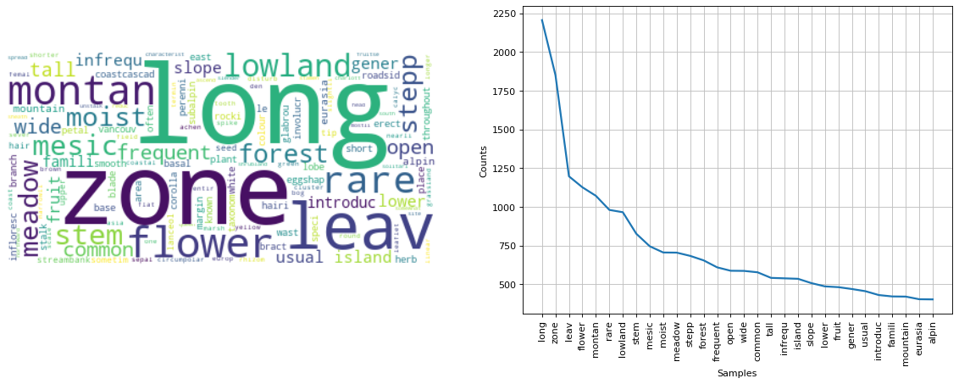


Flora Prepper: Preparing floras for morphological parsing and integration
Jocelyn Pender, Agriculture and Agri-Food Canada, Ottawa, Canada
Rationale
Results
Text Length
Taxon Id
Morphology
The future of floras is online and integrated. But how do we get legacy botanical texts rapidly parsed and integrated with other content?
Content types must be annotated (i.e., text represents names, morphology, discussion or distribution).
Previous floral content annotation projects have focused on developing software for manual annotation (Sauter et al. 2012) and regular expressions (Hamann et al. 2014).
Word Clouds by Classification
Taxon identification
Morphology
Habitat
Key
Raw
Clean
Model Performance (Q1-Q3)
A programmatic and model-based solution to text annotation would be modular (easy to implement in programmatic workflows) and flexible.
Flora prepper is a pilot project to build a text classifier to prepare three floras for downstream data preparation, parsing and integration.
Model Performance Model | Accuracy
Raw DTM | 98%
Raw TFIDF | 92%
Clean DTM | 92%
Clean TFIDF | 86%
Raw DTM + text length | 98%
Raw DTM + top 2000 words | 95%
Habitat
Key
Raw
Incorrectly Classified Text
The vision of an integrated digitally available Flora of Canada. Top image via: Flora of North America Editorial Committee, eds. 1993+ Vol. 5. Bottom image via G. Levin & J. Macklin 2017.
Clean
Predicted: Morphology, Actual: Key
1 Calyptra minute, tightly adherent at or near the apex of the capsule, persistent; capsule…
Predicted: Taxon ID, Actual: Key
Key to the Species and Taxonomic Notes
Predicted: Key, Actual: Morphology
﻿Leaves Stem leaves compound, divided 1-3 times without bulbils in axils; leaflets more than 5 times as long as broad…
Predicted: Habitat, Actual: Taxon Id
﻿California poppy
Predicted: Morphology, Actual: Habitat
﻿Base and trunks of trees
Methods
Questions
Most Informative Features
of the raw DTM model
Q1: Can we build a useful Machine Learning (ML) model to classify text strings into one of four classifications (taxon identification, morphology, habitat or key)?
Q2: Are punctuation, numbers, white space, brackets, symbols and word endings meaningful for floral text classification?
Q3: Is the length of text strings to be classified meaningful?
Q4: Can a model trained on floras be applied to previously unseen floras (i.e., are floras representative of each other)?
Taxon identification | Colon, comma, rank designations* (variety, family, species, genus), brackets, period, semi-colon *artefact of FNA taxon id strings. Not all floras will contain these.
Morphology | Glabrous, multiplication symbol (×), leaves, units (cm, mm), brackets, semi-colon, period, comma
Habitat | Habitat descriptors (lowland, dry, montane, zones), directions (E, N), BC✢, period, semi-colon, comma ✢ artefact of dataset Illustrated Flora of BC
Key | Key, numbers (e.g., 2,1), usually, brackets, units (e.g., mm), period, semi-colon, comma
Data
How important is the training set to model performance? (Q4)
Three floras were ingested and split into text fragments:
Flora of North America (text already tagged)
Budd’s Flora of the Canadian Prairie Provinces (text manually tagged)
Illustrated Flora of British Columbia (text already tagged)
Word Frequency Distribution by Flora
A model trained on 2 floras and tested on the third had an accuracy rate of 80%, precision of 85% and an F1 score of 80%.
Term frequency distributions are similar among floras. Punctuation is the most common token, followed by measurement units, and plant structure descriptors (leaf, stem, flower).
Training set
Testing set
Raw
Clean
Discussion
Budd’s Flora
As the proportion of FNA & BC went down, accuracy went down.
Overfitting?
taxon id not really relevant – gnfinder
key & morpho – super tricky
results are optimistic, a little bit too high - skeptical
Images above from:
Flora of North Am.
Workflow
The entire workflow was built in Python 3 (incl. text processing and model building). See GitHub repo for specific packages used.
Data was either kept raw or cleaned. Models were run with either a Document-Term Matrix (DTM) or a Term–Frequency Inverse-Document-Frequency (TFIDF) matrix.
A model was run with text length included as a feature.
Cleaning regime:
Numbers removed
Short words removed
Punctuation removed
Words stemmed and lemmatized
Illus. Flora of BC
References
Data credits
FNA is from us
Budds is from BHL
Ill.s bc, provisional permission from Del (data cannot be released at this time)
FNA
Budds
Illus. BC
credit images
Sautter
Hamann.
Cui H et al. (2016) Introducing Explorer of Taxon Concepts with a case study on spider measurement matrix building. BMC Bioinformatics 17: 471. https://doi.org/10.1186/s12859-016-1352-7
Page R. (2016) Towards a biodiversity knowledge graph. Research Ideas and Outcomes 2: e8767. https://doi.org/10.3897/rio.2.e8767
Models were built and tested using MultinomialNB from sklearn.
Contact us!
Jocelyn.Pender@canada.ca
Joel.Sachs@agr.gc.ca
Photo by Annie Spratt on Unsplash

